Slide 1
Continuity

Slide 2
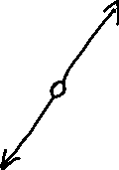


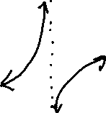
The idea of continuity can be thought of informally as the idea of being able to draw a graph without lifting one’s pencil.
Three types of discontinuity are illustrated below.
Jump Discontinuity (common in piecewise functions)
Vertical Asymptote
Hole

Slide 3

Now for a more formal definition.
The function $f$ is continuous at $x=a$ if $f(a)$ is defined and if
$f\left(a\right)=\begin{matrix}lim⁡ \\ x→a\end{matrix} f(x)$

Slide 4

Example
a) Graph the function
$f\left(x\right)= \begin{matrix}x^{2}−3,x≤−1 \\ x−1,x>−1\end{matrix}$
b) Determine $f(−1)$
c) Determine $\begin{matrix}\lim{} \\ x→−1\end{matrix} f(x)$
d) Is $f$ continuous at $x=−1$?

Slide 5
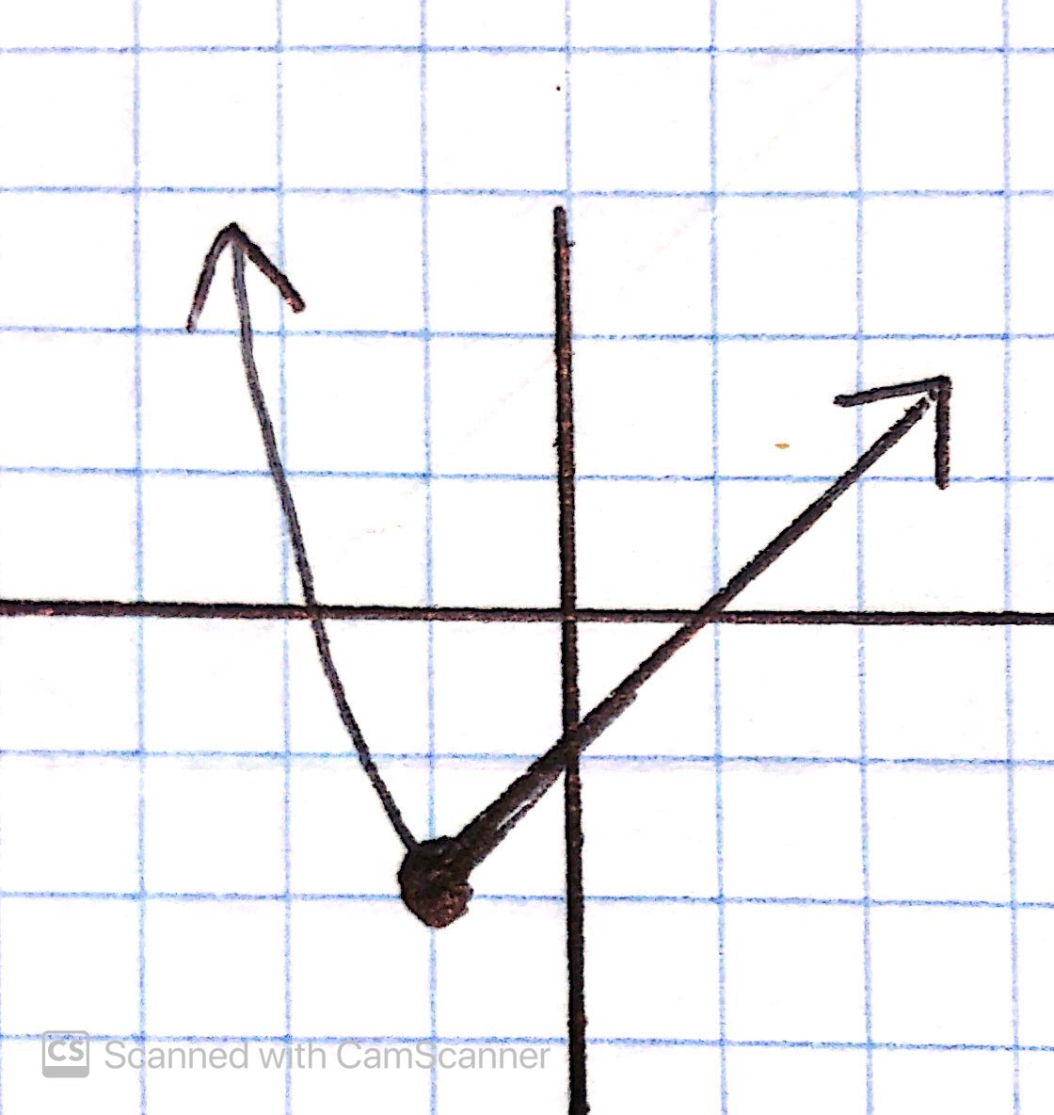
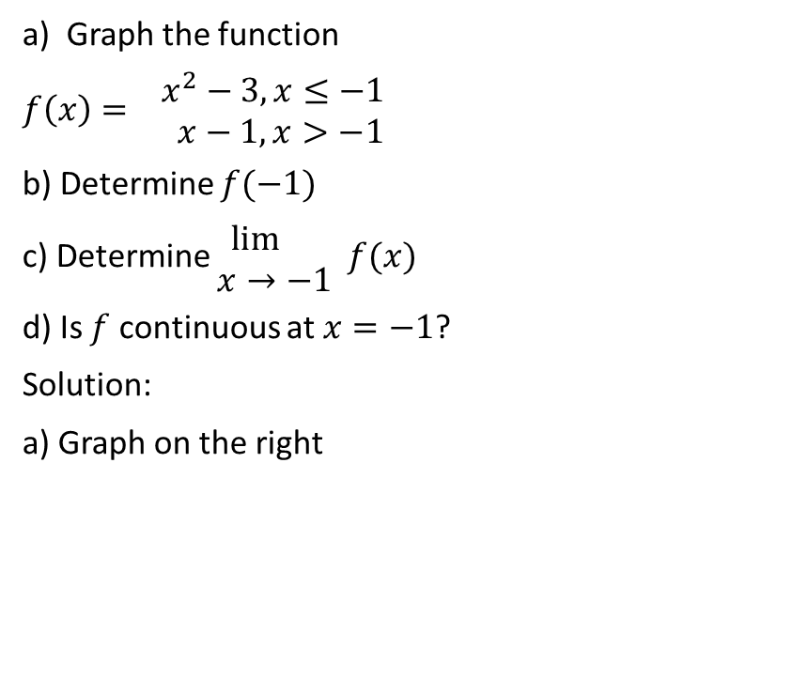
a) Graph the function
$f\left(x\right)= \begin{matrix}x^{2}−3,x≤−1 \\ x−1,x>−1\end{matrix}$
b) Determine $f(−1)$
c) Determine $\begin{matrix}\lim{} \\ x→−1\end{matrix} f(x)$
d) Is $f$ continuous at $x=−1$?
Solution:
a) Graph on the right

Slide 6
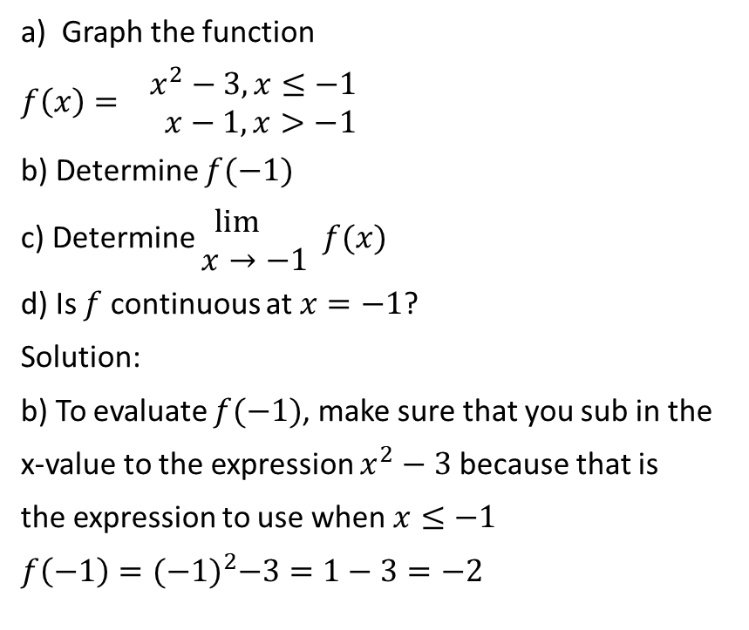
a) Graph the function
$f\left(x\right)= \begin{matrix}x^{2}−3,x≤−1 \\ x−1,x>−1\end{matrix}$
b) Determine $f(−1)$
c) Determine $\begin{matrix}\lim{} \\ x→−1\end{matrix} f(x)$
d) Is $f$ continuous at $x=−1$?
Solution:
b) To evaluate $f(−1)$, make sure that you sub in the
x-value to the expression $x^{2}−3$ because that is
the expression to use when $x≤−1$
$f\left(−1\right)={(−1)}^{2}−3=1−3=−2$

Slide 7

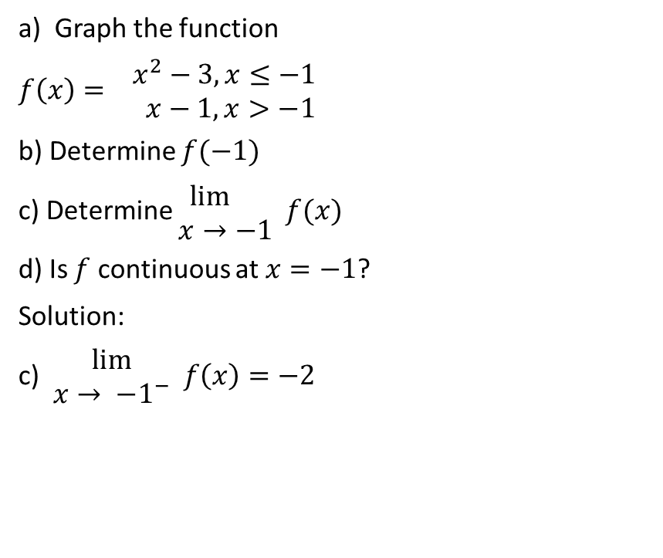
a) Graph the function
$f\left(x\right)= \begin{matrix}x^{2}−3,x≤−1 \\ x−1,x>−1\end{matrix}$
b) Determine $f(−1)$
c) Determine $\begin{matrix}\lim{} \\ x→−1\end{matrix} f(x)$
d) Is $f$ continuous at $x=−1$?
Solution:
c) $\begin{matrix}lim⁡ \\ x→ {−1}^{−}\end{matrix} f\left(x\right)=−2$

Slide 8

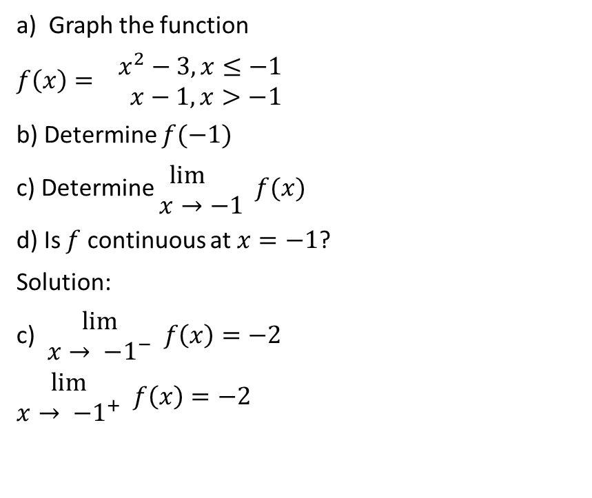
a) Graph the function
$f\left(x\right)= \begin{matrix}x^{2}−3,x≤−1 \\ x−1,x>−1\end{matrix}$
b) Determine $f(−1)$
c) Determine $\begin{matrix}\lim{} \\ x→−1\end{matrix} f(x)$
d) Is $f$ continuous at $x=−1$?
Solution:
c) $\begin{matrix}lim⁡ \\ x→ {−1}^{−}\end{matrix} f\left(x\right)=−2$
$\begin{matrix}lim⁡ \\ x→ {−1}^{+}\end{matrix} f\left(x\right)=−2$

Slide 9
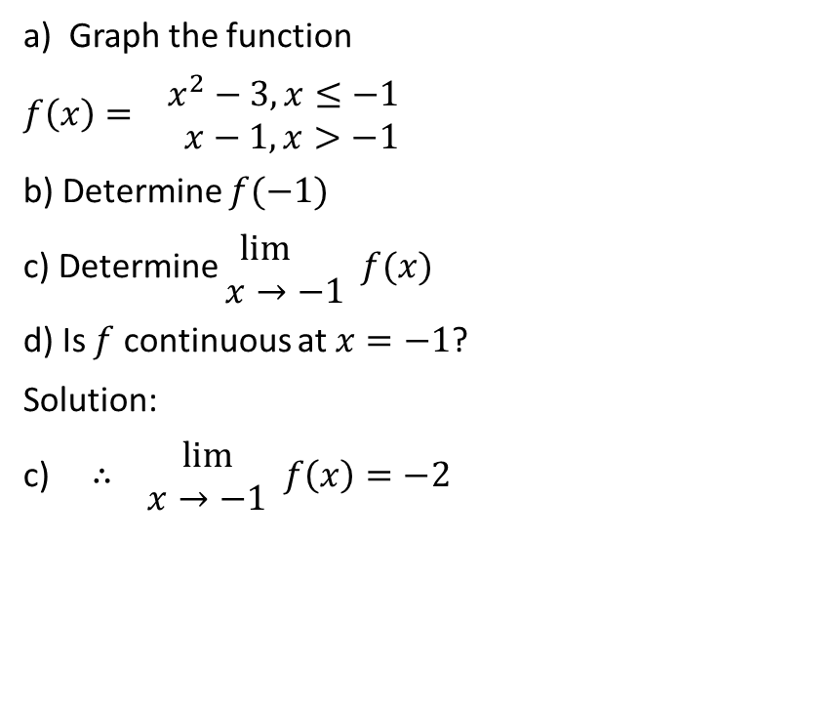
a) Graph the function
$f\left(x\right)= \begin{matrix}x^{2}−3,x≤−1 \\ x−1,x>−1\end{matrix}$
b) Determine $f(−1)$
c) Determine $\begin{matrix}\lim{} \\ x→−1\end{matrix} f(x)$
d) Is $f$ continuous at $x=−1$?
Solution:
c) $∴ \begin{matrix}lim⁡ \\ x→−1\end{matrix} f\left(x\right)=−2$

Slide 10
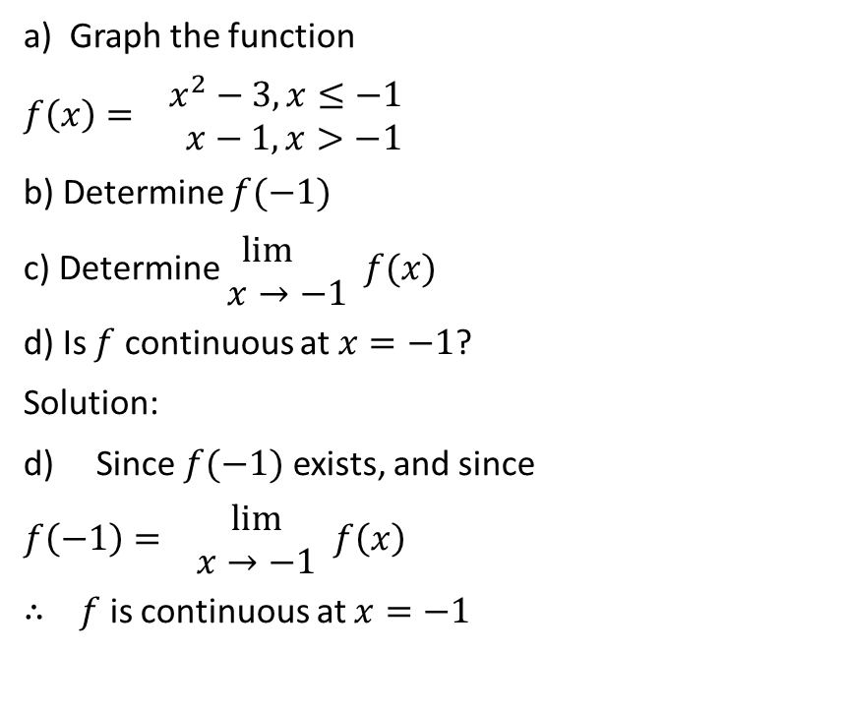
a) Graph the function
$f\left(x\right)= \begin{matrix}x^{2}−3,x≤−1 \\ x−1,x>−1\end{matrix}$
b) Determine $f(−1)$
c) Determine $\begin{matrix}\lim{} \\ x→−1\end{matrix} f(x)$
d) Is $f$ continuous at $x=−1$?
Solution:
d) Since $f(−1)$ exists, and since
$f\left(−1\right)= \begin{matrix}lim⁡ \\ x→−1\end{matrix} f\left(x\right)$
$∴ f$ is continuous at $x=−1$

Slide 11

Example
Is the function $f\left(x\right)=x^{3}−x$ continuous at $x=2$?

Slide 12
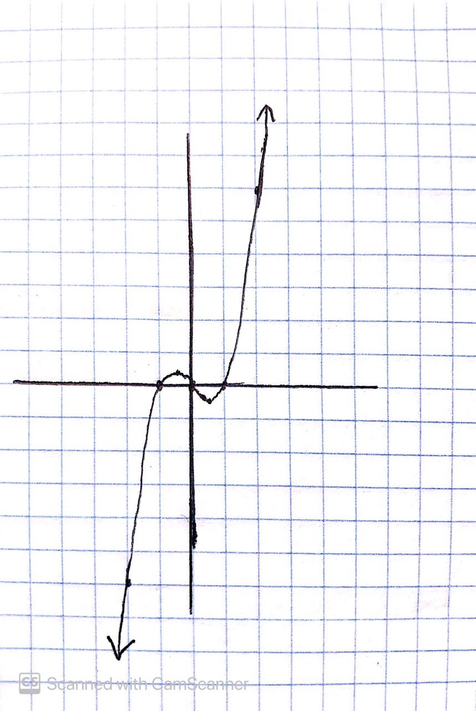

Is the function $f\left(x\right)=x^{3}−x$ continuous at $x=2$?
Solution:
$f\left(2\right)={(2)}^{3}−\left(2\right)=8−2=6$

Slide 13

Is the function $f\left(x\right)=x^{3}−x$ continuous at $x=2$?
Solution:
$\begin{matrix}lim⁡ \\ x→2^{−}\end{matrix} f\left(x\right)=6$

Slide 14
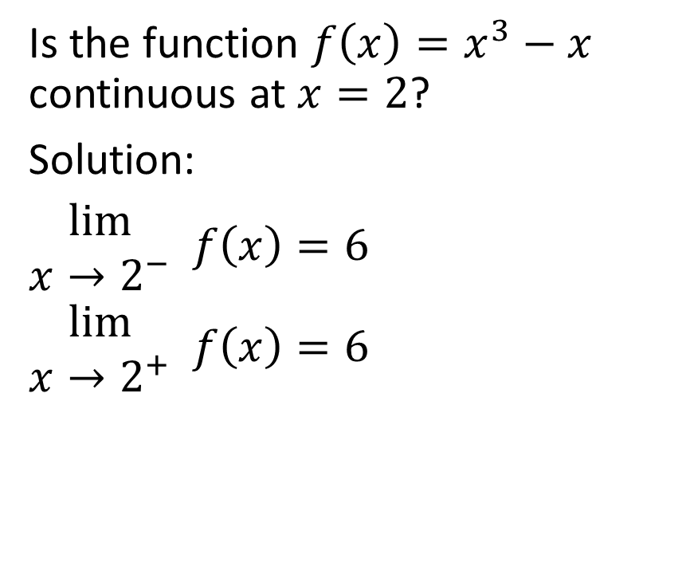
Is the function $f\left(x\right)=x^{3}−x$ continuous at $x=2$?
Solution:
$\begin{matrix}lim⁡ \\ x→2^{−}\end{matrix} f\left(x\right)=6$
$\begin{matrix}lim⁡ \\ x→2^{+}\end{matrix} f\left(x\right)=6$

Slide 15
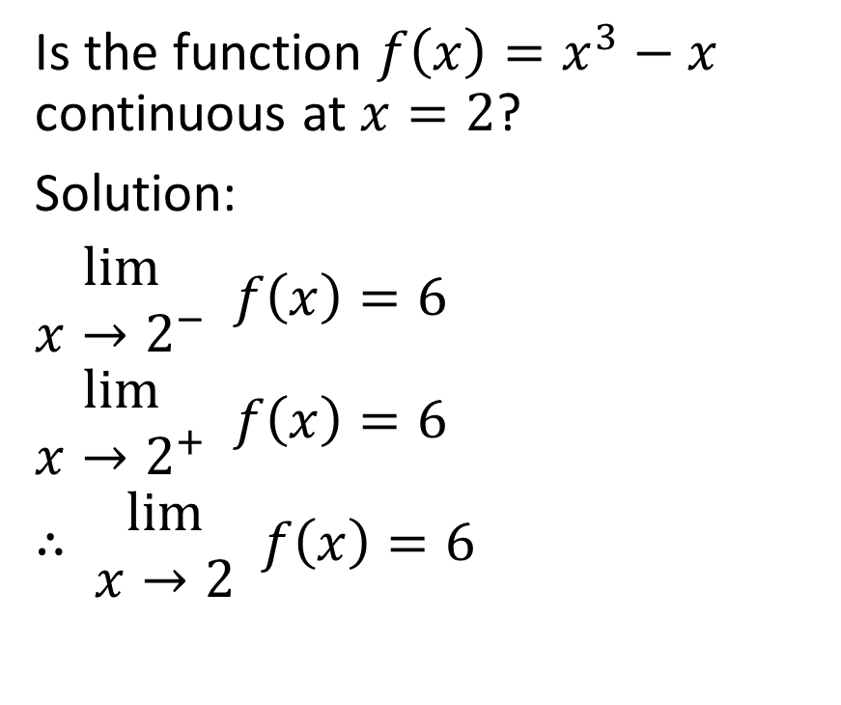
Is the function $f\left(x\right)=x^{3}−x$ continuous at $x=2$?
Solution:
$\begin{matrix}lim⁡ \\ x→2^{−}\end{matrix} f\left(x\right)=6$
$\begin{matrix}lim⁡ \\ x→2^{+}\end{matrix} f\left(x\right)=6$
$∴ \begin{matrix}lim⁡ \\ x→2\end{matrix} f\left(x\right)=6$

Slide 16
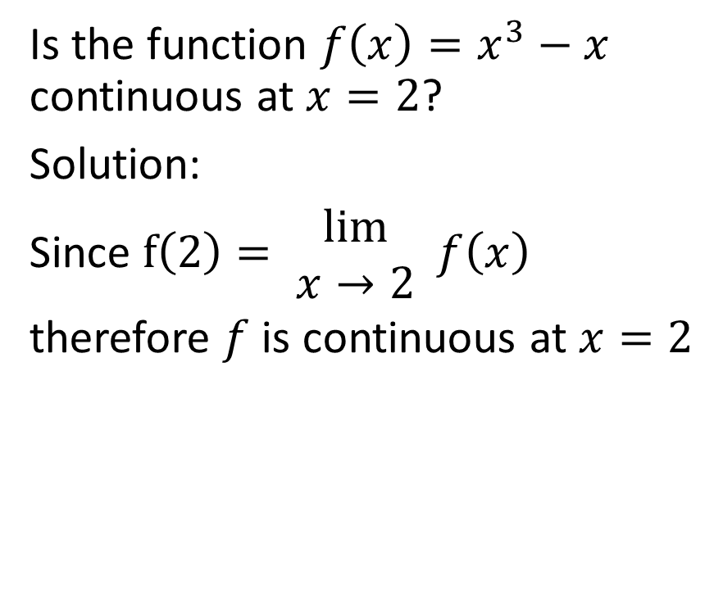
Is the function $f\left(x\right)=x^{3}−x$ continuous at $x=2$?
Solution:
Since $f\left(2\right)= \begin{matrix}lim⁡ \\ x→2\end{matrix} f\left(x\right)$
therefore $f$ is continuous at $x=2$

Slide 17

Example
Is the function $f\left(x\right)=\frac{x^{2}−x−2}{x−2}$ continuous at $x=2$?

Slide 18
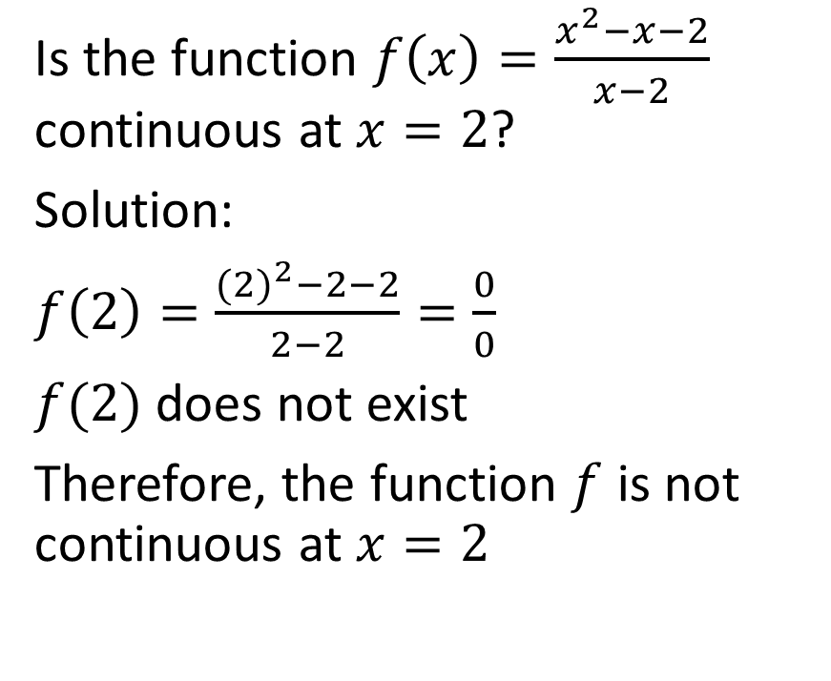
Is the function $f\left(x\right)=\frac{x^{2}−x−2}{x−2}$ continuous at $x=2$?
Solution:
$f\left(2\right)=\frac{{(2)}^{2}−2−2}{2−2}=\frac{0}{0}$
$f(2)$ does not exist
Therefore, the function $f$ is not continuous at $x=2$

Slide 19

Example
Is the function
$f\left(x\right)= \begin{matrix}\frac{x^{2}−x−2}{x−2},x≠2 \\ 3, x=2\end{matrix}$
continuous at $x=2$?

Slide 20
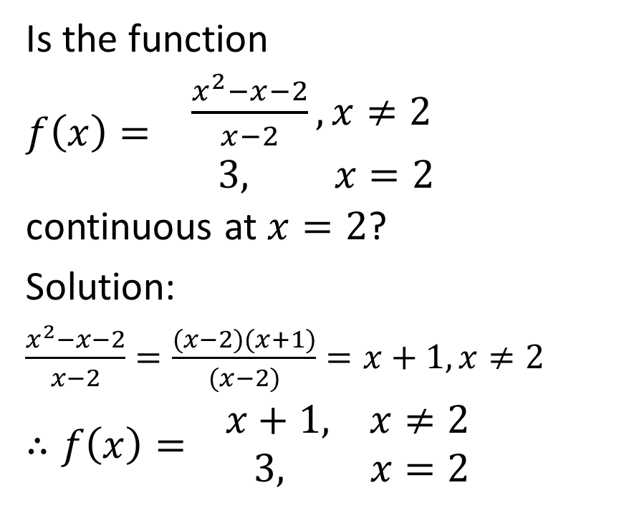
Is the function
$f\left(x\right)= \begin{matrix}\frac{x^{2}−x−2}{x−2},x≠2 \\ 3, x=2\end{matrix}$
continuous at $x=2$?
Solution:
$\frac{x^{2}−x−2}{x−2}=\frac{(x−2)(x+1)}{(x−2)}=x+1, x≠2$
$∴f\left(x\right)= \begin{matrix}x+1, x≠2 \\ 3, x=2\end{matrix}$

Slide 21
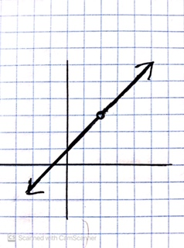
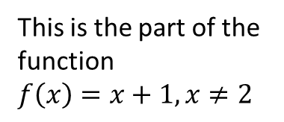
Is the function
$f\left(x\right)= \begin{matrix}\frac{x^{2}−x−2}{x−2},x≠2 \\ 3, x=2\end{matrix}$
continuous at $x=2$?
Solution:
$\frac{x^{2}−x−2}{x−2}=\frac{(x−2)(x+1)}{(x−2)}=x+1, x≠2$
$∴f\left(x\right)= \begin{matrix}x+1, x≠2 \\ 3, x=2\end{matrix}$
This is the part of the function
$f\left(x\right)=x+1,x≠2$

Slide 22
Is the function
$f\left(x\right)= \begin{matrix}\frac{x^{2}−x−2}{x−2},x≠2 \\ 3, x=2\end{matrix}$
continuous at $x=2$?
Solution:
$\frac{x^{2}−x−2}{x−2}=\frac{(x−2)(x+1)}{(x−2)}=x+1, x≠2$
$∴f\left(x\right)= \begin{matrix}x+1, x≠2 \\ 3, x=2\end{matrix}$
Next, we shade in the open circle, representing the point where f(x) = 3 when x = 2

Slide 23
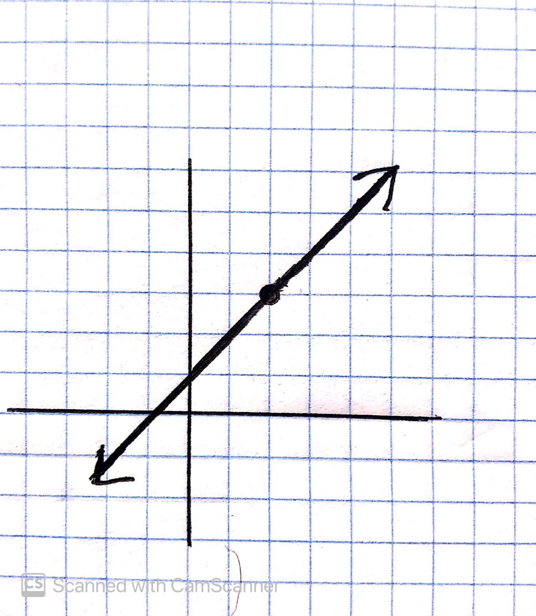
Is the function
$f\left(x\right)= \begin{matrix}\frac{x^{2}−x−2}{x−2},x≠2 \\ 3, x=2\end{matrix}$
continuous at $x=2$?
Solution:
$\frac{x^{2}−x−2}{x−2}=\frac{(x−2)(x+1)}{(x−2)}=x+1, x≠2$
$∴f\left(x\right)= \begin{matrix}x+1, x≠2 \\ 3, x=2\end{matrix}$

Slide 24
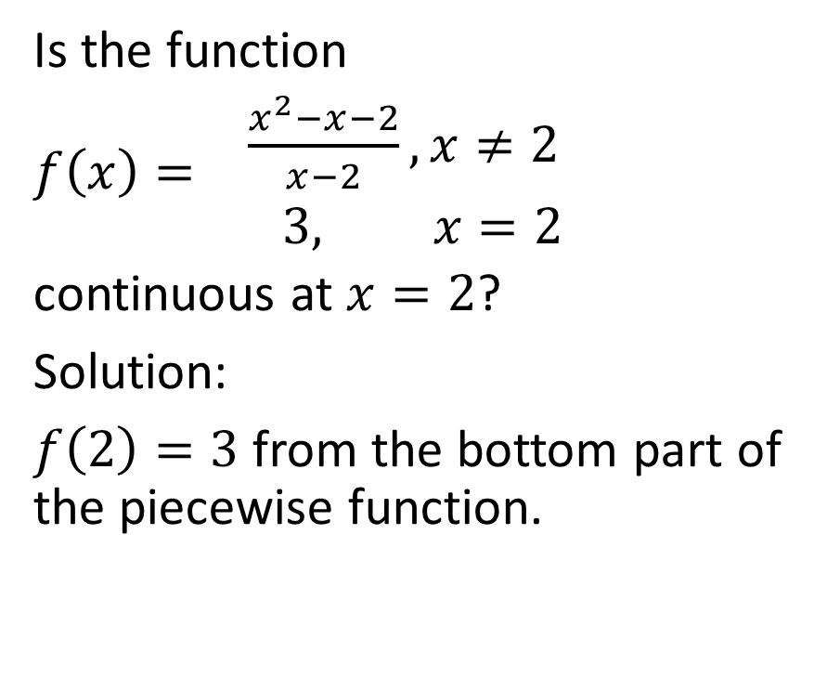
Is the function
$f\left(x\right)= \begin{matrix}\frac{x^{2}−x−2}{x−2},x≠2 \\ 3, x=2\end{matrix}$
continuous at $x=2$?
Solution:
$f\left(2\right)=3$ from the bottom part of the piecewise function.

Slide 25

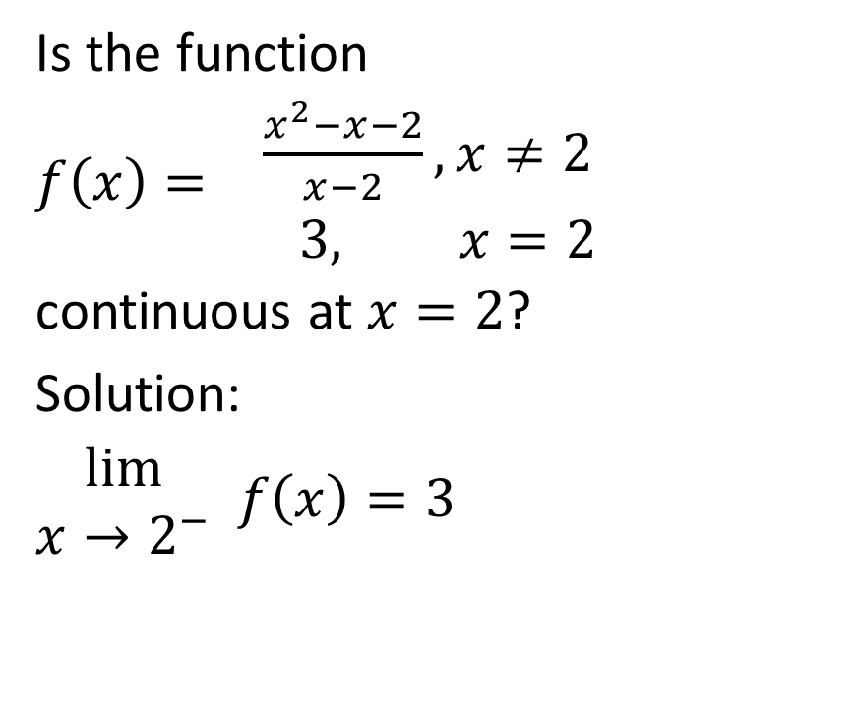
Is the function
$f\left(x\right)= \begin{matrix}\frac{x^{2}−x−2}{x−2},x≠2 \\ 3, x=2\end{matrix}$
continuous at $x=2$?
Solution:
$\begin{matrix}lim⁡ \\ x→2^{−}\end{matrix} f\left(x\right)=3$

Slide 26

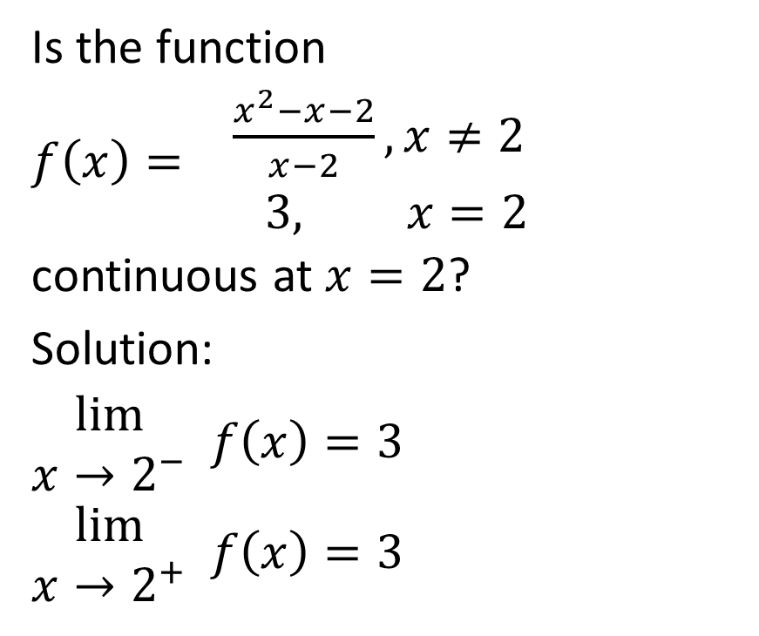
Is the function
$f\left(x\right)= \begin{matrix}\frac{x^{2}−x−2}{x−2},x≠2 \\ 3, x=2\end{matrix}$
continuous at $x=2$?
Solution:
$\begin{matrix}lim⁡ \\ x→2^{−}\end{matrix} f\left(x\right)=3$
$\begin{matrix}lim⁡ \\ x→2^{+}\end{matrix} f\left(x\right)=3$

Slide 27
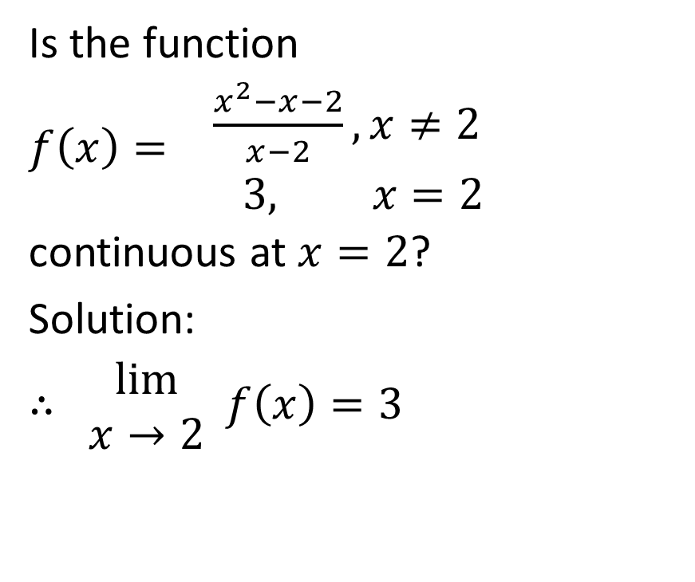
Is the function
$f\left(x\right)= \begin{matrix}\frac{x^{2}−x−2}{x−2},x≠2 \\ 3, x=2\end{matrix}$
continuous at $x=2$?
Solution:
$∴ \begin{matrix}lim⁡ \\ x→2\end{matrix} f\left(x\right)=3$

Slide 28
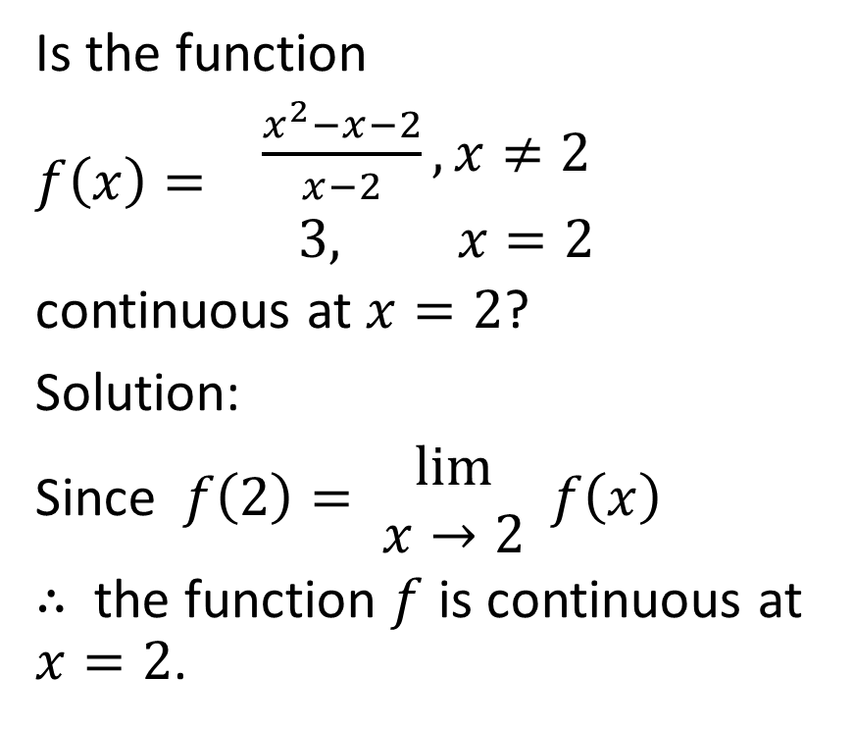
Is the function
$f\left(x\right)= \begin{matrix}\frac{x^{2}−x−2}{x−2},x≠2 \\ 3, x=2\end{matrix}$
continuous at $x=2$?
Solution:
Since $f\left(2\right)= \begin{matrix}lim⁡ \\ x→2\end{matrix} f\left(x\right)$
$∴$ the function $f$ is continuous at $x=2$.

Slide 29

Example
Determine whether the function
$f\left(x\right)= \begin{matrix}5−x^{2}, x<1 \\ 3,x≥1\end{matrix}$
is continuous at $x=1$.

Slide 30
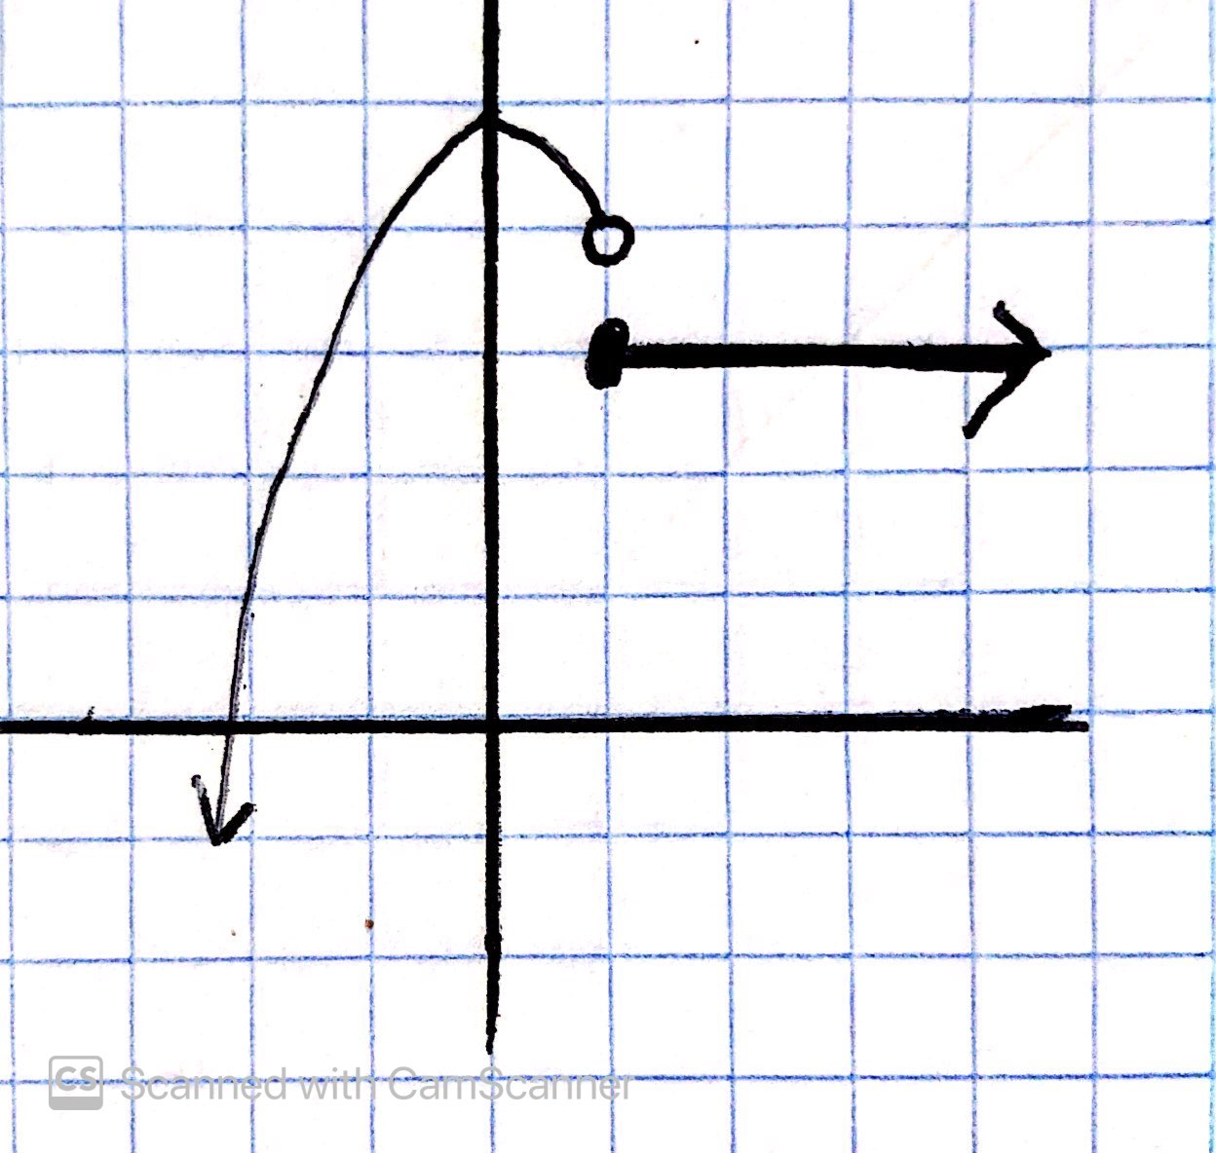
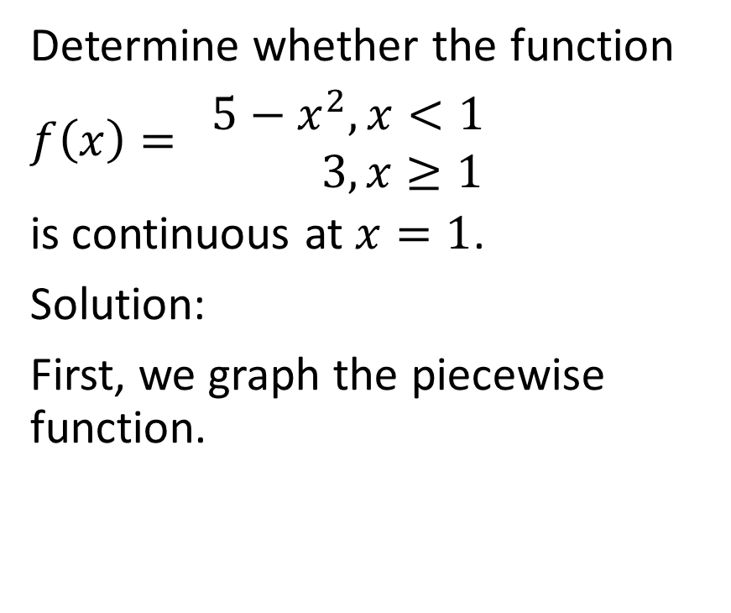
Determine whether the function
$f\left(x\right)= \begin{matrix}5−x^{2}, x<1 \\ 3,x≥1\end{matrix}$
is continuous at $x=1$.
Solution:
First, we graph the piecewise function.

Slide 31
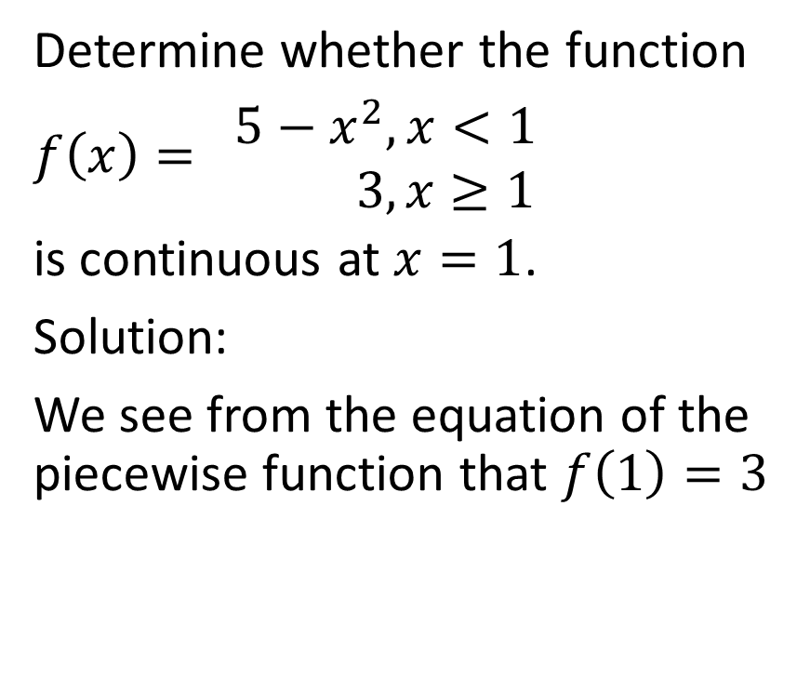
Determine whether the function
$f\left(x\right)= \begin{matrix}5−x^{2}, x<1 \\ 3,x≥1\end{matrix}$
is continuous at $x=1$.
Solution:
We see from the equation of the piecewise function that $f\left(1\right)=3$

Slide 32
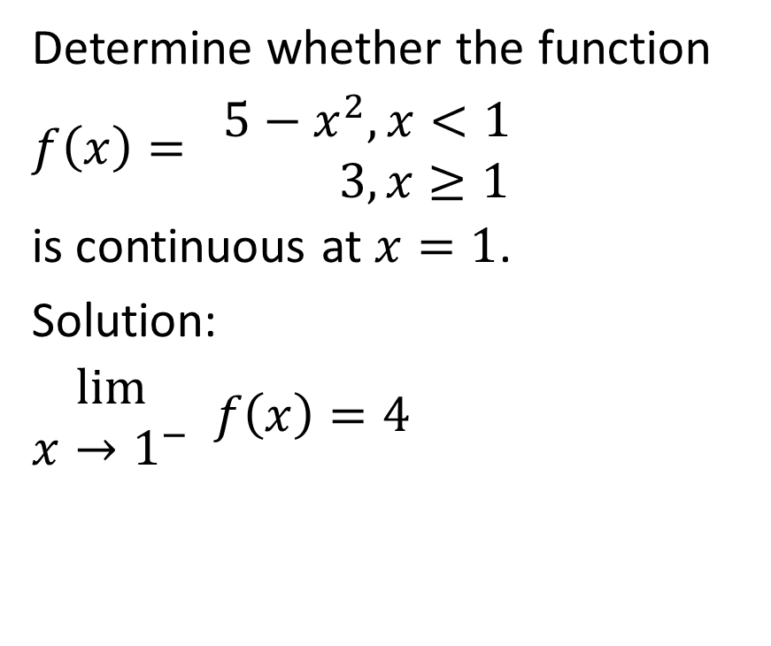
Determine whether the function
$f\left(x\right)= \begin{matrix}5−x^{2}, x<1 \\ 3,x≥1\end{matrix}$
is continuous at $x=1$.
Solution:
$\begin{matrix}lim⁡ \\ x→1^{−}\end{matrix} f\left(x\right)=4$

Slide 33
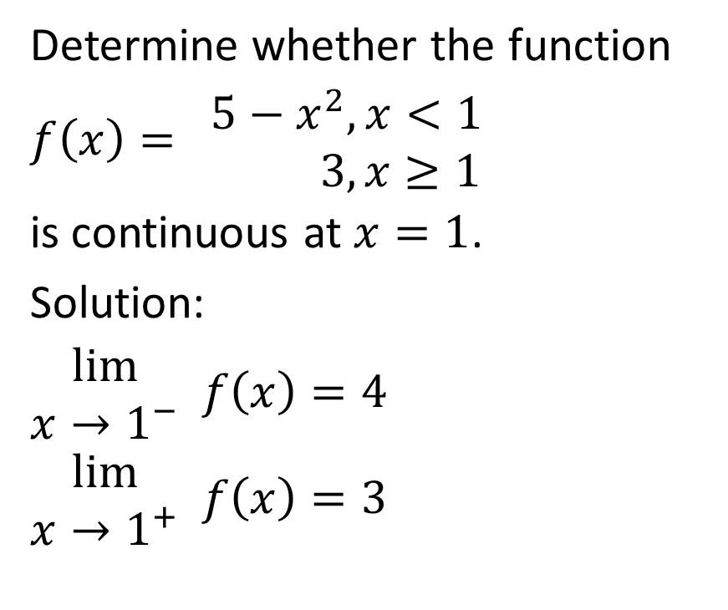
Determine whether the function
$f\left(x\right)= \begin{matrix}5−x^{2}, x<1 \\ 3,x≥1\end{matrix}$
is continuous at $x=1$.
Solution:
$\begin{matrix}lim⁡ \\ x→1^{−}\end{matrix} f\left(x\right)=4$
$\begin{matrix}lim⁡ \\ x→1^{+}\end{matrix} f\left(x\right)=3$

Slide 34
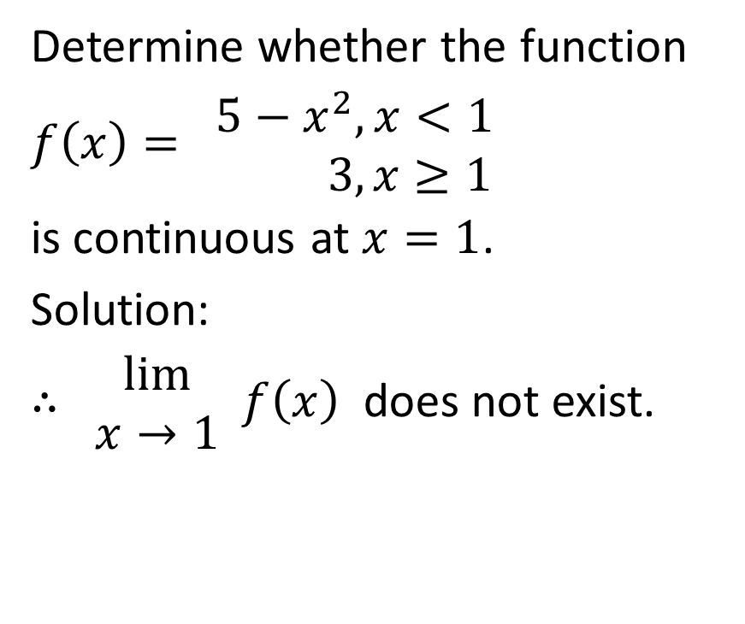
Determine whether the function
$f\left(x\right)= \begin{matrix}5−x^{2}, x<1 \\ 3,x≥1\end{matrix}$
is continuous at $x=1$.
Solution:
$∴ \begin{matrix}lim⁡ \\ x→1\end{matrix} f\left(x\right)$ does not exist.

Slide 35
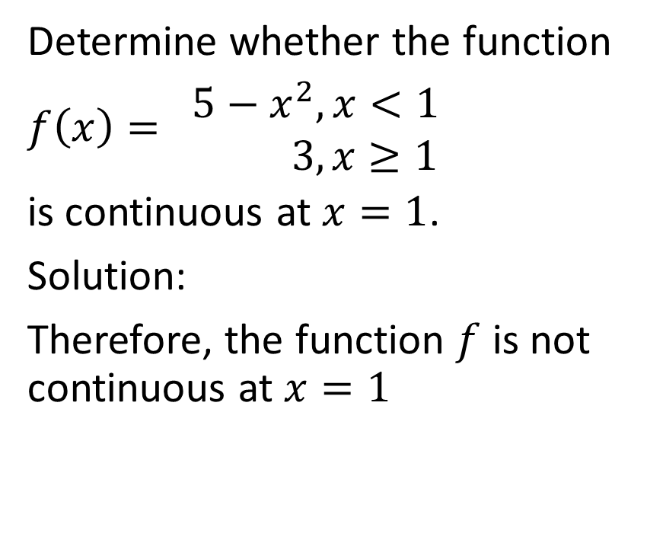
Determine whether the function
$f\left(x\right)= \begin{matrix}5−x^{2}, x<1 \\ 3,x≥1\end{matrix}$
is continuous at $x=1$.
Solution:
Therefore, the function $f$ is not continuous at $x=1$

Slide 36
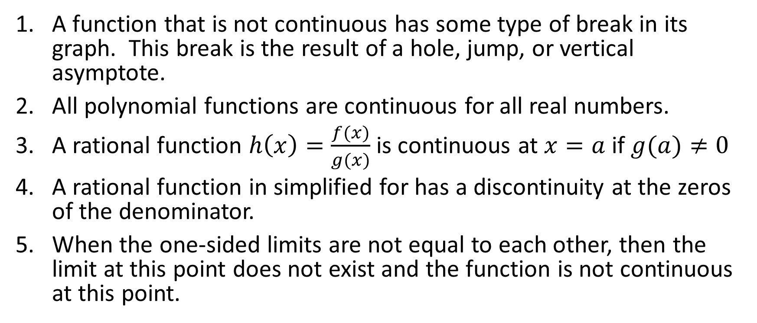
General Observations Regarding Continuity
A function that is not continuous has some type of break in its graph. This break is the result of a hole, jump, or vertical asymptote.
All polynomial functions are continuous for all real numbers.
A rational function $h\left(x\right)=\frac{f(x)}{g(x)}$ is continuous at $x=a$ if $g(a)≠0$
A rational function in simplified for has a discontinuity at the zeros of the denominator.
When the one-sided limits are not equal to each other, then the limit at this point does not exist and the function is not continuous at this point.

Slide 37

Example
Determine the value of k such that the function
$f\left(x\right)= \begin{matrix}3−kx,x<4 \\ x^{2}, x≥4\end{matrix}$
is continuous over all $x∈R$

Slide 38
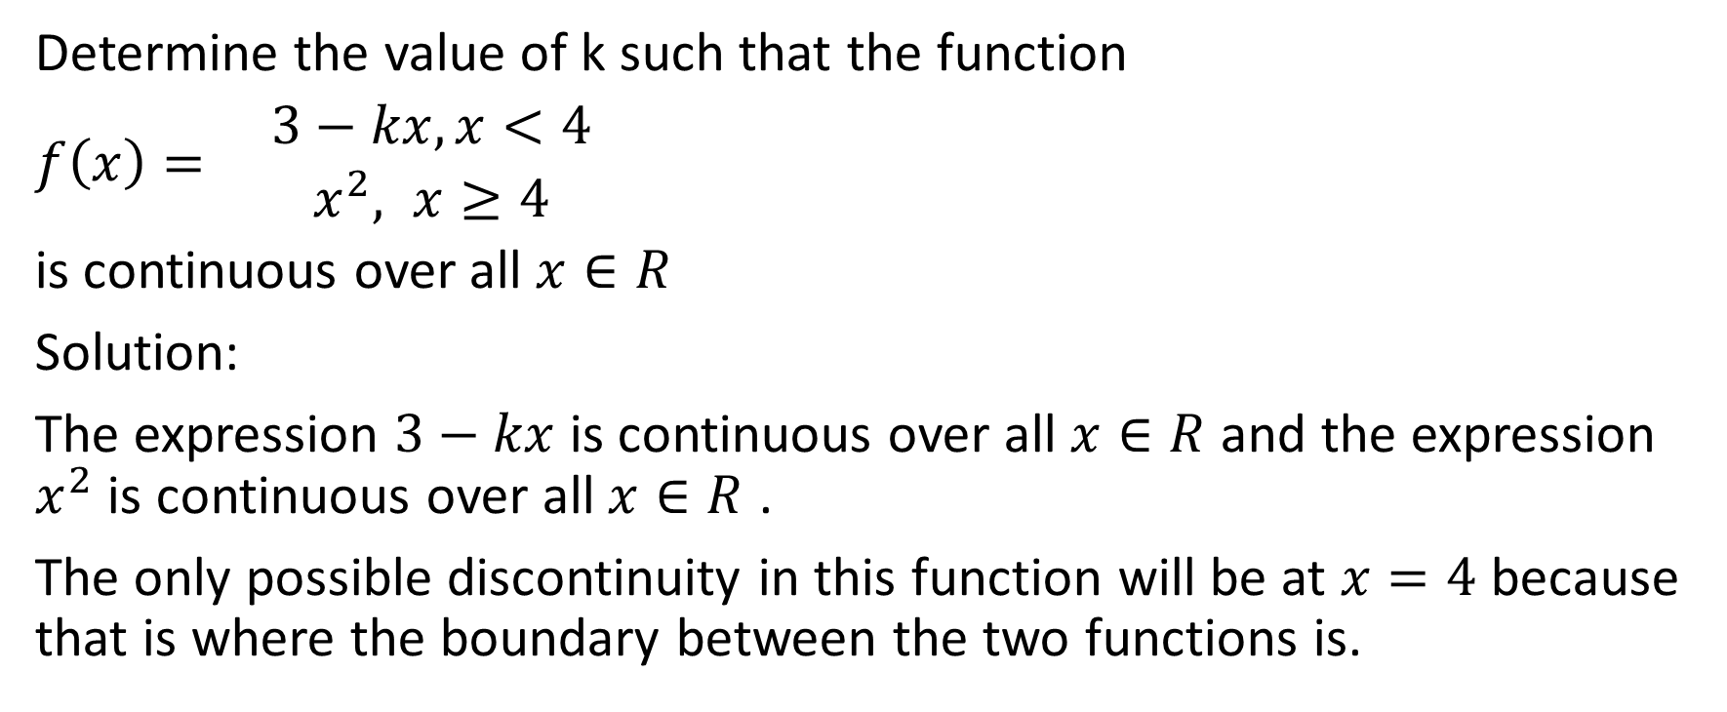
Determine the value of k such that the function
$f\left(x\right)= \begin{matrix}3−kx,x<4 \\ x^{2}, x≥4\end{matrix}$
is continuous over all $x∈R$
Solution:
The expression $3−kx$ is continuous over all $x∈R$ and the expression $x^{2}$ is continuous over all $x∈R$ .
The only possible discontinuity in this function will be at $x=4$ because that is where the boundary between the two functions is.

Slide 39
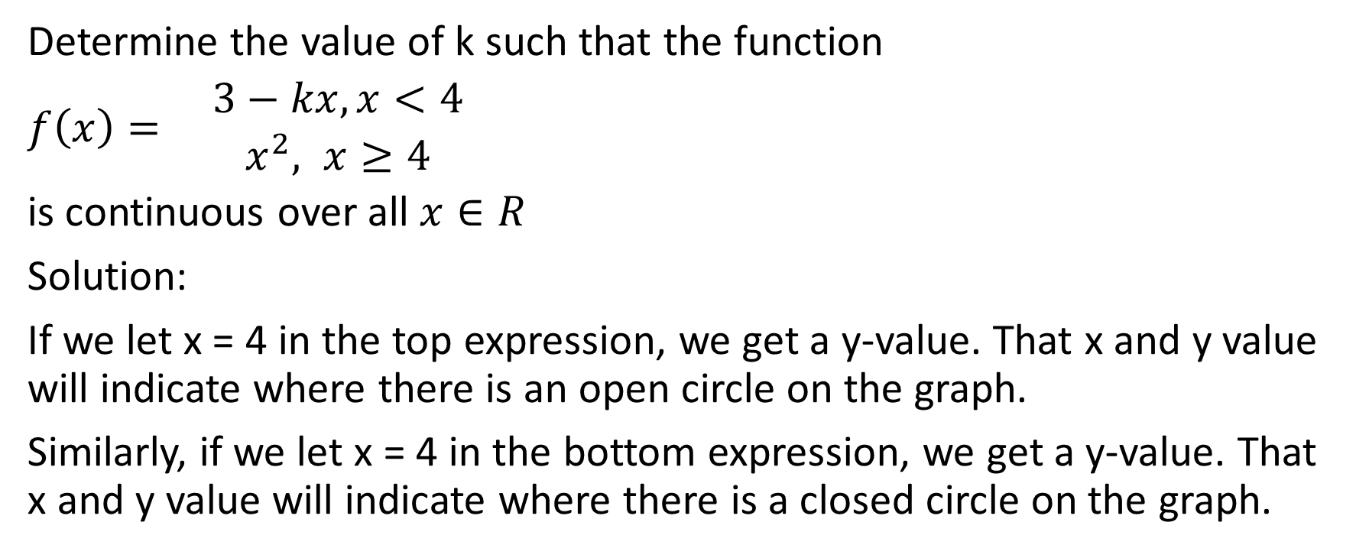
Determine the value of k such that the function
$f\left(x\right)= \begin{matrix}3−kx,x<4 \\ x^{2}, x≥4\end{matrix}$
is continuous over all $x∈R$
Solution:
If we let x = 4 in the top expression, we get a y-value. That x and y value will indicate where there is an open circle on the graph.
Similarly, if we let x = 4 in the bottom expression, we get a y-value. That x and y value will indicate where there is a closed circle on the graph.

Slide 40
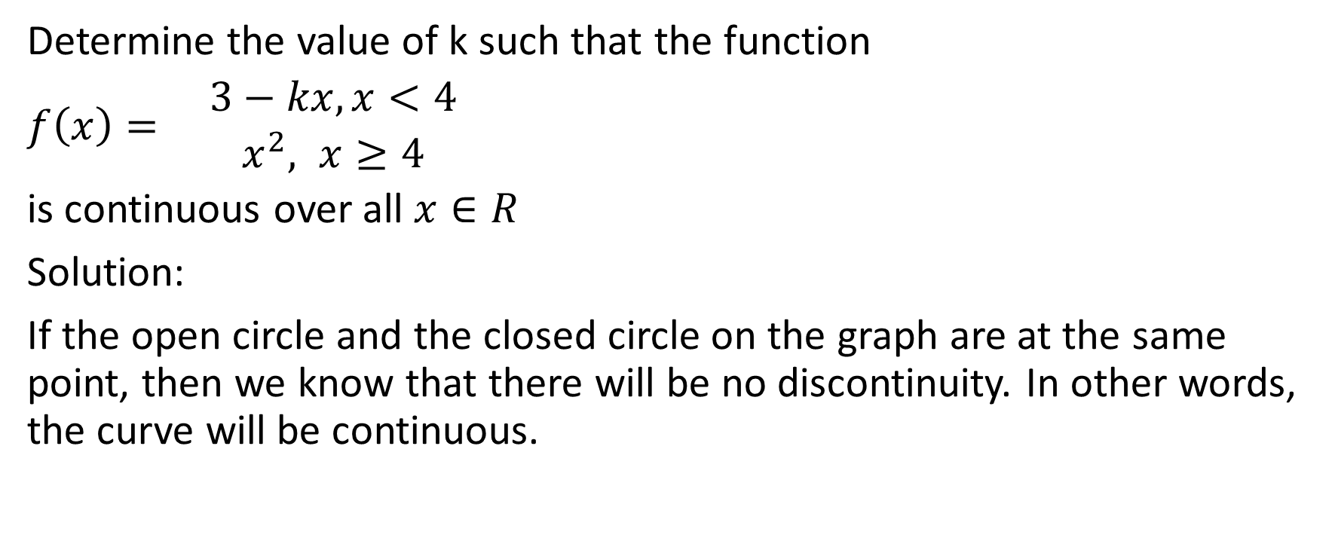
Determine the value of k such that the function
$f\left(x\right)= \begin{matrix}3−kx,x<4 \\ x^{2}, x≥4\end{matrix}$
is continuous over all $x∈R$
Solution:
If the open circle and the closed circle on the graph are at the same point, then we know that there will be no discontinuity. In other words, the curve will be continuous.

Slide 41
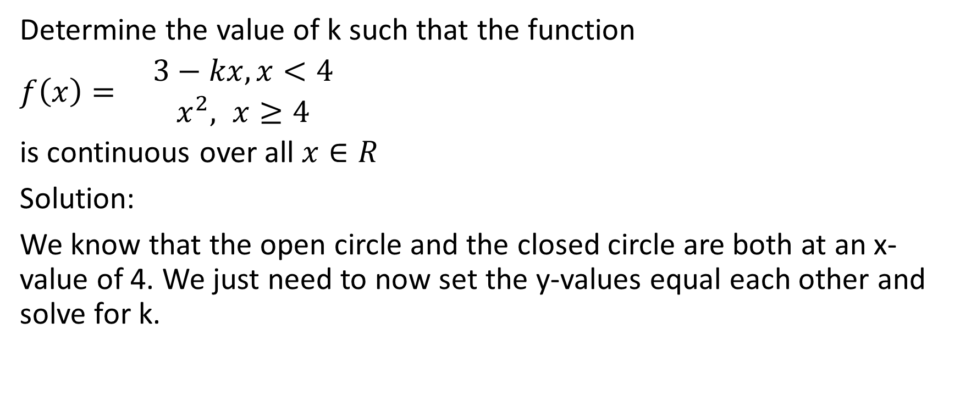
Determine the value of k such that the function
$f\left(x\right)= \begin{matrix}3−kx,x<4 \\ x^{2}, x≥4\end{matrix}$
is continuous over all $x∈R$
Solution:
We know that the open circle and the closed circle are both at an x-value of 4. We just need to now set the y-values equal each other and solve for k.

Slide 42
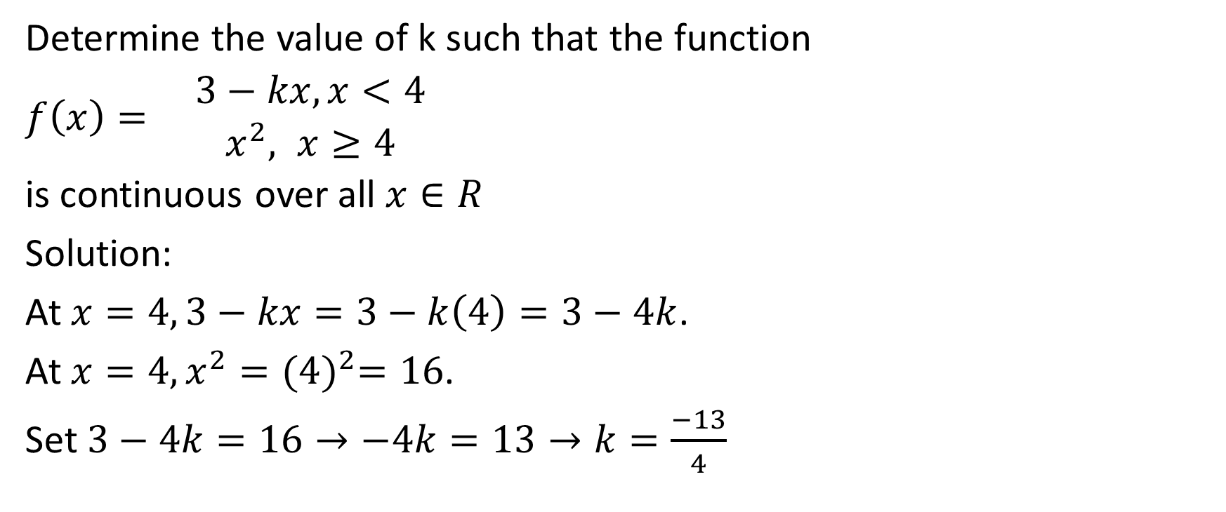
Determine the value of k such that the function
$f\left(x\right)= \begin{matrix}3−kx,x<4 \\ x^{2}, x≥4\end{matrix}$
is continuous over all $x∈R$
Solution:
At $x=4, 3−kx=3−k\left(4\right)=3−4k$.
At $x=4, x^{2}={(4)}^{2}=16$.
Set $3−4k=16→−4k=13→k=\frac{−13}{4}$

Slide 43
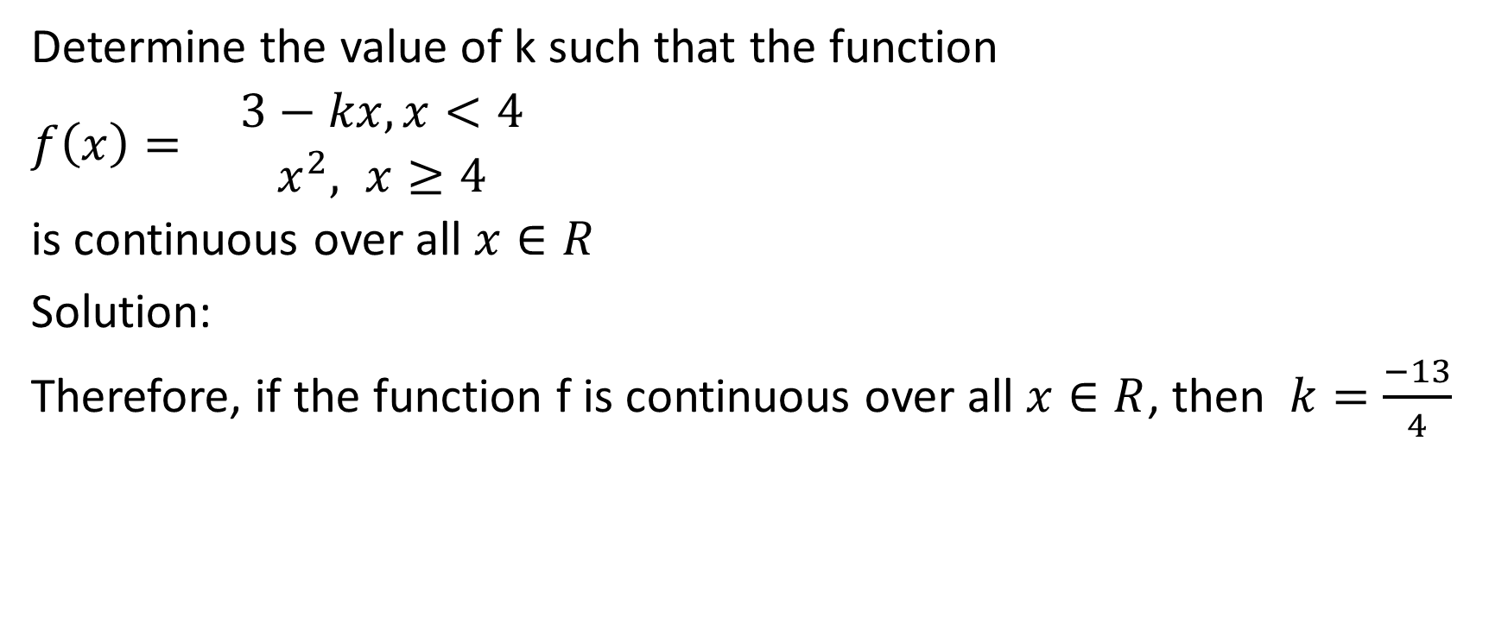
Determine the value of k such that the function
$f\left(x\right)= \begin{matrix}3−kx,x<4 \\ x^{2}, x≥4\end{matrix}$
is continuous over all $x∈R$
Solution:
Therefore, if the function f is continuous over all $x∈R$, then $k=\frac{−13}{4}$

